Slide 1


COVID-19 Update: Erin Guthrie, Director
Illinois Department of Commerce & Economic Opportunity (DCEO)

Slide 2

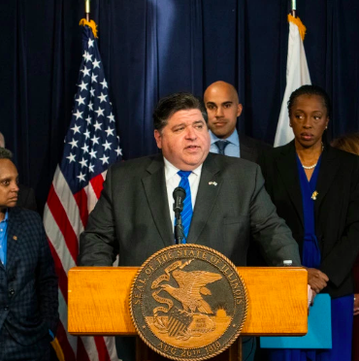
State’s Response to COVID-19
Governor JB Pritzker announced a new package of $90 million in emergency assistance programs for small businesses around Illinois
More info: http://www.illinois.gov/dceo
Programs include:
  Small Business Emergency Loan Fund
  Downstate Small Business Stabilization Fund
COVID-19: Update from Erin Guthrie, Director of the Illinois Department of Commerce & Economic Opportunity (DCEO)

Slide 3
Illinois Small Business Emergency Loan Fund
$60 million fund to support low-interest loans of up to $50,000 for small businesses outside of Chicago.
Businesses with fewer than 50 employees and less than $3 million in revenue in 2019 will be eligible to apply.
Successful applicants will owe nothing for six months and then will begin making fixed payments at 3% interest for the remainder of a five-year loan repayment period with no payments due for the first six months.
Loan funds must be used for working capital. At least 50% of loan proceeds must be applied toward payroll or other eligible compensation, with a commitment to hire or retain at least 50% of a business workforce for six months.
Eligible businesses can submit a full application online now here.
Chicago-based business qualify for a similar program – The Chicago Small Business Resiliency Fund
COVID-19: Update from Erin Guthrie, Director of the Illinois Department of Commerce & Economic Opportunity (DCEO)

Slide 4
Downstate Small Business Stabilization Fund
This new $20 million program supports non-essential small businesses in suburban and rural counties across Illinois.
Provides grants up to $25,000 to small businesses in communities served by DCEO’s Office of Community Development.
Businesses with up to 50 employees can partner with local governments to obtain grants of up to $25,000 in working capital.
The program redeploys Community Development Block Grant funds to support local small businesses.
You can find out additional information and apply here.
COVID-19: Update from Erin Guthrie, Director of the Illinois Department of Commerce & Economic Opportunity (DCEO)

Slide 5
SBA Economic Injury Disaster Loans for Illinois Small Businesses
Small businesses in all 102 Illinois counties may be eligible for low-interest, economic injury disaster loans up to $2M per business from the U.S. Small Business Administration.
Interest rates:
  3.75% for small businesses
  2.75%for nonprofit organizations with terms up to 30 years
Eligibility requirements are determined by SBA and can be found on our DCEO COVID-19 Resources for Businesses

Slide 6
Federal Stimulus Bill – CARES Act
Paycheck Protection Program: the SBA will provide $349 billion in loans to small businesses and non-profits under 500 employees impacted by COVID. The loans can be forgiven when an employer maintains or rehires their workforce.
  Faith based organizations, sole proprietors, independent contractors and self-employed also eligible. Additional eligibility applies.
  Funds to help cover expenses like payroll, rent, mortgage interest, and utilities.
  Loans can be up to $10 million and interest rates are 1% for portions of the loan that do not qualify for loan forgiveness.
  Businesses can start applying April 3rd; Independent contractors and self-employed April 10th.
Economic Injury Disaster Loan: Borrowers can receive an emergency advance up to $10,000 within 3 days of a successful application and DO NOT have to repay the advance if they are denied a loan.
  The SBA has the advance in place now.
  Those eligible include small businesses, non-profits, tribal businesses under 500 employees. Faith based organizations, sole proprietors, independent contractors and self-employed also eligible. Additional eligibility applies.
Subsidy for Current Loan Payments: the SBA will cover up to 6 months of principal and interest payments that are owed on most existing SBA loans.
Training and Advising for Existing Businesses: additional funds are provided to SBDCs, Women’s Business Centers, and Minority Business Centers for education, training and advising to small businesses. Small Businesses can take advantage of this now.
Aid to Midsize Businesses and Nonprofits: These entities will be able to take advantage of a federal loan program to support their organizations. Significant restrictions will be placed on the assistance and these loans cannot be forgiven.
Information is updated daily as the federal government develops program details. Interested parties should continue to refer to the SBA’s Coronavirus website for up-to-date information. https://www.sba.gov/page/coronavirus-covid-19-small-business-guidance-loan-resources. Midsize business and nonprofit loans are being developed by the U.S. Treasury and Federal Reserve. https://www.federalreserve.gov/covid-19.htm

Slide 7
Unemployment Insurance
Individuals without access to paid sick leave or unable to work due to COVID-19 can apply for unemployment insurance by visiting the IDES website: IDES.Illinois.gov
Gov. Pritzker is waiving the 7-day waiting period for residents to apply for unemployment benefits
Federal CARES Act:
  Extended length of benefits from 26 weeks to 39 weeks
  Additional $600 per week
  Independent contractors/gig workers can access benefits (IDES in process of setting up this program)
COVID-19: Update from Erin Guthrie, Director of the Illinois Department of Commerce & Economic Opportunity (DCEO)

Slide 8

Bringg NOW
In response to the increasing demand for delivery to reduce the spread of COVID-19, Bringg releases new SME solution for free to help businesses manage delivery to customers.
Using BringgNOW business owners can quickly load incoming orders, dispatch deliveries to their own drivers or crowdsourced fleets and deliver items to customers with a fully branded, real-time Uber-like experience.
What this means:
  BringgNOW will provide smaller businesses the ability to start, scale, and manage delivery operations
COVID-19: Update from Erin Guthrie, Director of the Illinois Department of Commerce & Economic Opportunity (DCEO)
Website: www.bringg.com
If interested contact
Michael Pomerantz (Michael.Pomerantz@illinois.com)

Slide 9
PPE Donations Needed
For donations of personal protective equipment, please email: PPE.donations@illinois.gov.
PPE Items include:
Masks: N-95, ear loop, or surgical
Gowns: Isolation or non-descript
Gloves: Nitrile, sterile, or surgical
Eye Protection: Face shields and goggles
Infection Control Kits
Hand Sanitizer: Any size
Disinfectant Wipes: Any size
Digital thermometers: Forehead only
PAPR hoods
Ventilators

Slide 10
Additional Donations
For non-PPE items please email: BusinessDonations@illinois.gov
Manufacturers altering operations to provide essential items can contact the Illinois Manufacturers Association (IMA) at: https://ima-net.org/covid-19/supplies/
Wholesalers, suppliers, or manufacturers that have items on hand to sell or will in the future can contact: COVID.procurement@illinois.gov.

Slide 11

NEW Illinois COVID-19 Response Fund
Gov. Pritzker is partnering with United Way of Illinois and Alliance of Illinois Community Foundations to launch Illinois’ COVID-19 Response Fund (ICRF)
Created to support nonprofit organizations serving those who lives have been upended by COVID-19 – launching with nearly $23 million
Steering committee will disburse funds to the initial wave of charitable organizations and all donations and distributions will be available to the public
More information can be found at www.ilcovidresponsefund.org
COVID-19: Update from Erin Guthrie, Director of the Illinois Department of Commerce & Economic Opportunity (DCEO)

Slide 12
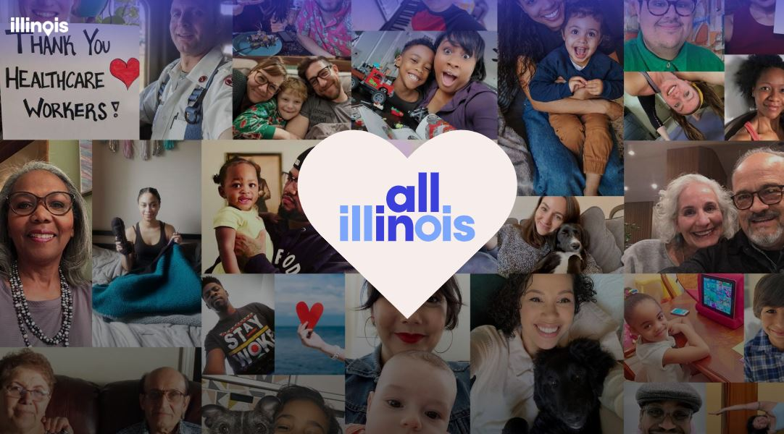
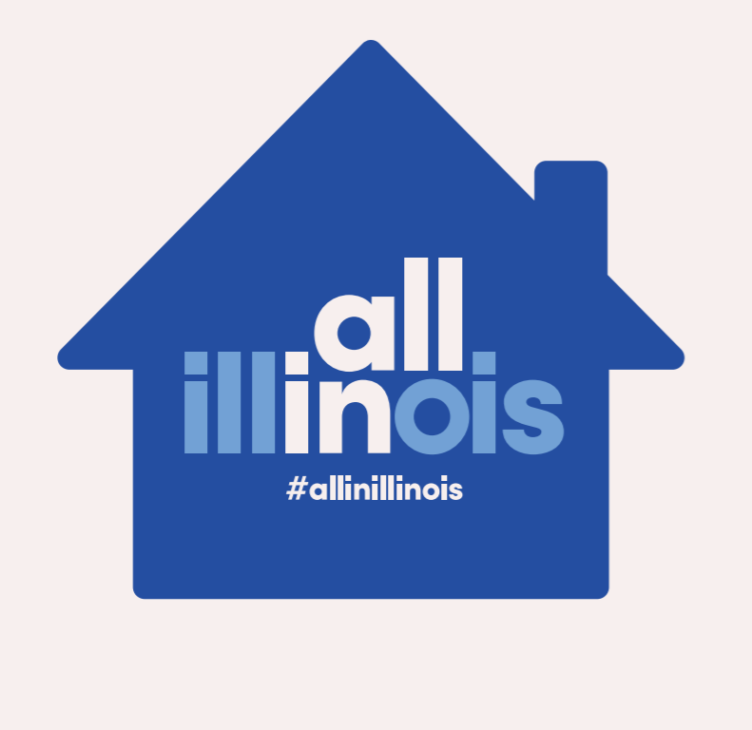
#AllinIllinois
On April 2, Governor JB Pritzker introduced All In Illinois to unite residents across the state to continue to stay home and stay safe.
Join us and take the pledge to being 'All In' — for our neighbors and grandparents, our health care professionals and first responders, our grocery store workers and so many more.
Print a sign, change your profile picture, or share a celebrity PSA on social media.
Visit http://allin.Illinois.gov

Slide 13



For More Information
General Inquires: 1-800-252-2923 or CEO.support@illinois.gov
Essential Business inquiries: contact 1-800-252-2923 or CEO.support@illinois.gov – Frequently Asked Questions
Business insurance coverage: contact the Department of Insurance (DOI) to file an online complaint: https://mc.insurance.illinois.gov/messagecenter.nsf
Federal Small Business loans visit: https://disasterloan.sba.gov
Governor’s Office COVID-19 Website: coronavirus.illinois.gov
DCEO COVID-19 Resources: https://dceocovid19resources.com/
COVID-19: Update from Erin Guthrie, Director of the Illinois Department of Commerce & Economic Opportunity (DCEO)

Slide 14
Q&A
COVID-19: Update from Erin Guthrie, Director of the Illinois Department of Commerce & Economic Opportunity (DCEO)

